Slide 1
TOPIC:
Introduction to Computer Organization & Architecture
(Lecture 1)
By – Dr. Girish Wadhwa

Slide 2
What is Computer Architecture?
Refers to the those attribute of a system visible to a programmer or those attributes that has direct impact on the logical executions of a program.
It describes the function of various units of digital computers that store and process information.
It is planned, design policy or technology.
What is Computer Organization?
Refers to the operational mints or types and their interconnections that realize their architecture specification.
It provides deep knowledge of functionality, structuring, internal working, and implementation of a computer system.
The role of computer organization comes after Computer architecture.

Slide 3
Difference between Computer Architecture and Computer Organisation
S. No. | Computer Architecture | Computer Organisation
1. | They explain what a computer does. | They explain how a computer actually does it.
2. | They majorly focus on the functional behavior of computer systems. | They majorly focus on the structural relationship and deep knowledge of the internal working of a system.
3. | Computer architectures deal with high-level design matters. | They deal with low-level design matters.
4. | It comes before computer organisation. | It comes after the architecture part.
5. | It covers logical functions, such as registers, data types, instruction sets, and addressing modes. | It covers physical units like peripherals, circuit designs, and adders.

Slide 4
Historical Perspective
Computers of today developed over past 85 years
1930’s: Slow mechanical calculating devices
1940’s: Electromechanical devices
First electronic computer using vacuum tubes: University of Pennsylvania
Development of technology used to fabricate processor, I/O, memory divided into 4 generations:
First generation (1945-1955)
Second generation (1955-1965)
Third generation (1965-1975)
Fourth generation (1975-present day)

Slide 5
First generation computers
Idea of storing programs in memory: Von Neumann
Program and data stored in the same memory
Assembly language used to prepare program, translated into machine language instruction for program execution
Magnetic core memory & magnetic tape storage devices developed

Slide 6
Second generation computers
Transistors replaced vacuum tubes
Magnetic core memory
Magnetic disc storage devices developed
High level language developed: easy to prepare program
Compilers or Interprator developed to translate high level language program to assembly and to machine language instructions

Slide 7
Third generation computers
Invention of IC
Cheap and fast processor and memory elements
IC memory replaced magnetic core memory
Introduction of cache memory, virtual memory

Slide 8
Fourth generation computers
Processor and large portion of main memory on a single chip
Millions of transistors on a single chip: VLSI
Processor evolved to microprocessor
Intel, National Semiconductor, Motorola, TI
Architectural concepts evolved
Desktop computer, notebook computer

Slide 9
Historical Perspective
First generation
Second generation
Third generation
Fourth generation
Mechanical & electromechanical devices
Vacuum tube
Transistor
IC
VLSI
1000-fold increase in speed
1000-fold increase in speed
1000-fold increase in speed

Slide 10
Computer Architecture: Von-Neumann/ Princeton
Program and data memory same
Single bus (for address and data)
Instruction fetch and data transfer can’t be same time
Processor
I/O Unit
Program & Data Memory
Address bus
Data bus
Data/Instruction bus

Slide 11
Computer Architecture: Harvard
Separate program and data memory
Separate buses for program and data memory
Instruction fetch and data transfer can be same time
Modified Harvard: separate cache memory, but same main memory
Processor
Program Memory
Address bus
I/O Unit
Instruction bus
Data bus
Data Memory
Address bus
Data bus

Slide 12
Central Processing Unit: Introduction, General Register Organization

Slide 13
Outline
Central Processing Unit (CPU)
Introduction
Central processing unit
Central processing unit commonly known as CPU can be referred as an electronic circuitry within a computer that carries out the instructions given by a computer program by performing the basic arithmetic, logical, control and input/output (I/O) operations specified by the instructions.

Slide 14
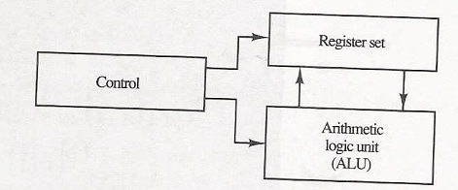
Introduction
The part of computer that performs the bulk of data-processing operations is called the central processing unit and is referred to as the CPU.
The CPU is made up of three major parts:
The register set: stores intermediate data used during the execution of the instruction.
The ALU: performs the required micro-operations for executing the instructions.
The control unit: supervise the transfer of information among the registers and instruct the ALU as to which operation to perform.

Slide 15
Arithmetic & logical unit
Most of all the arithmetic and logical operations of a computer are executed in the ALU (Arithmetic and Logical Unit) of the processor. It performs arithmetic operations like addition, subtraction, multiplication, division and also the logical operations like AND, OR, NOT operations.
Control unit
The control unit is a component of a computer's central processing unit that coordinates the operation of the processor. It tells the computer's memory, arithmetic/logic unit and input and output devices how to respond to a program's instructions.
The control unit is also known as the nerve center of a computer system.

Slide 16
Memory unit
The memory unit in computer architecture is responsible for storing data and instructions that the CPU (Central Processing Unit) needs to execute tasks.
Memory units in computer architecture can be categorized into several types based on their speed, volatility, and purpose. Here are the main types:
Primary Memory (Main Memory)
Random Access Memory (RAM):
Dynamic RAM (DRAM):
- Slower and cheaper, DRAM needs to be refreshed periodically.
- Used in the main memory of most computers.
Static RAM (SRAM):
- Faster and more expensive, SRAM does not need to be refreshed.
- Used in cache memory.
Read-Only Memory (ROM):
- Non-volatile memory that is used to store software that is closely tied to specific hardware.
- Types include:
- PROM (Programmable ROM):** Can be programmed once after manufacturing.
- EPROM (Erasable PROM):** Can be erased and reprogrammed using UV light.
- EEPROM (Electrically Erasable PROM):** Can be erased and reprogrammed electronically.

Slide 17
Secondary Memory (Storage)
Hard Disk Drive (HDD):
- Magnetic storage, slower but with large storage capacity.
- Used for long-term storage of data and programs.
Solid State Drive (SSD):
- Faster than HDDs, using flash memory.
- More expensive but with better performance.
Optical Discs:
- Include CDs, DVDs, and Blue-rays.
- Used for storing data that can be read by optical drives.
Magnetic Tapes:
- Used for archival storage, slower access speed, but large capacity.
Cache Memory
- The smallest and fastest cache, located directly within the CPU or a separate chip close to the CPU.
Registers Memory
- The fastest type of memory, located within the CPU.
- Used for holding data that the CPU is currently processing, like operands and instructions.

Slide 18
Input unit
Input units are used by the computer to read the data. The most commonly used input devices are keyboards, mouse, joysticks, trackballs, microphones, etc.
Output Unit
The primary function of the output unit is to send the processed results to the user. Output devices display information in a way that the user can understand.

Slide 19
General Register Organization
A set of flip-flops forms a register. A register is a unique high-speed storage area in the CPU.
Memory locations are needed for storing data like pointers, counters address, return address, temporary result etc. Having to refer to memory location for such applications is time consuming because memory access is the most time-consuming operation in the computer.
It is more convenient and more efficient to store these intermediate values in processor registers. All of these registers are connect to a common bus system.
The register communicate with each other not only for direct data transfer, but also while performing various micro operations.
When large number of register included in the CPU then it is more efficient to connect through common bus system. A bus organization for seven CPU registers is shown in Figure below.

Slide 20
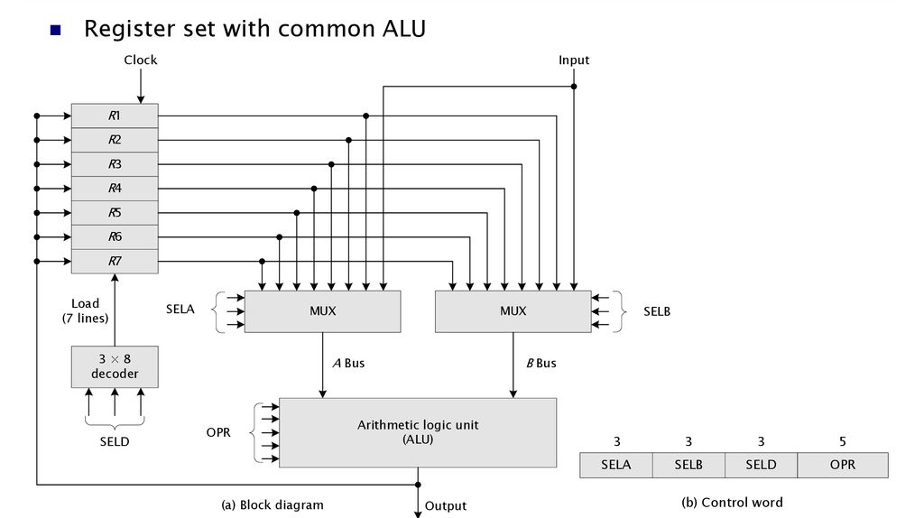
BUS System
The bus organization of 7-registers:

Slide 21
BUS System
To perform operation:
The control must provide binary selection variables to the following sectors inputs:
MUX A Sector (SELA): to place the content of R2 into bus A.
MUX B Sector (SELB): to place the content of R3 into bus B.
ALU operation Selector (OPR): To provide the arithmetic addition A+B.
Decoder Destination Selector (SELD): To transfer content of output bus in to R1.

Slide 22
BUS System
The four control selection variables are generated in control unit and must be available at the beginning of clock cycle.
The data from two source registers propagates through the gates in the multiplexers and the ALU, to the output bus, and into inputs of the destination register, all during the clock cycle interval.
When the next clock transition occurs, the binary information from the output bus is transferred into R1.

Slide 23

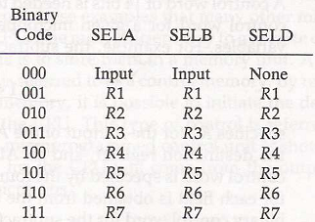
Control Word
There are 14 binary selection inputs in the unit, and their combined value specifies a control word.
The encoding of register selection field as:

Slide 24
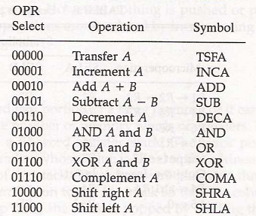
Control Word
The encoding of ALU operation as:
ALU provides arithmetic and logic operations. In addition, the CPU must provide shift operations.
The shifter may be placed in the input of the ALU to provide preshift capability, or at the output of ALU to provide postshift capability. Some times it included in ALU.

Slide 25


Microoperations
A control word of 14 bits is needed to specify a microoperations in the CPU.
E.g.
A memory unit that stores control word is referred to as a CONTROL MEMORY.
By reading consecutive control words from memory, it is possible to initiate the desire sequence of microoperations for the CPU. This type of control is referred As micro-programmed control.

Slide 26

TOPIC:
Computer Organization and Architecture
Basic Computer Organization: Instruction Codes
(Lectures 7-9)

Slide 27
INTRODUCTION Design of Processor
Every different processor type has its own design (different registers, buses, micro-operations, machine instructions, etc.)‏
Modern processor is a very complex device
It contains
Many registers
Multiple arithmetic units, for both integer and floating point calculations
DMA Controller and Pipeline etc.
However, to understand how processors work, we will start with a simplified processor model
This is similar to what real processors were like ~40 years ago
M. Morris Mano introduces a simple processor model he calls the Basic Computer

Slide 28
THE BASIC COMPUTER
The Basic Computer has two components, a processor and memory
The memory has 4096 words in it
4096 = 2¹², so it takes 12 bits to select a word in memory
Each word is 16 bits long
CPU
Program
A sequence of (machine) instructions
(Machine) Instruction
A group of bits that tell the computer to perform a specific operation (a sequence of micro-operation)
0
Memory Unit
15
0
4095

Slide 29
Instruction Codes

Slide 30
Instruction Codes
The organization of the computer is defined by its internal registers, the timing and control structure, and the set of instructions that it uses.
An instruction code is a group of bits that instruct the computer to perform a specific operation.
Instruction code is usually divided into two parts.
Operation part - Group of bits that define such operations as add, subtract, multiply, shift, and complement.
Address part - Contains register or memory word location where the address of operand is found, or the result is to be stored.
Each computer has its own instruction code format.

Slide 31
Operation Code
The operation code (op-code) of an instruction is a group of bits that define such operations as add, subtract, multiply, shift, and complement.
The number of bits required for the operation code of an instruction depends on the total number of operations available in the computer (n bits for 2^{n} operations).
Instruction Format
15
14
12
11
0
I
Opcode
Address
Addressing
mode

Slide 32
Stored Program Organization
Simplest way to organize computer is to have one processor register (Accumulator AC) and an instruction code format with two parts:
First-Operation to be performed
Second – Address
The memory address tells the control where to find an operand in memory.
Computers that have a single-processor register usually assign to it the name accumulator (AC).
The operation is performed with the memory operand and the content of AC.

Slide 33
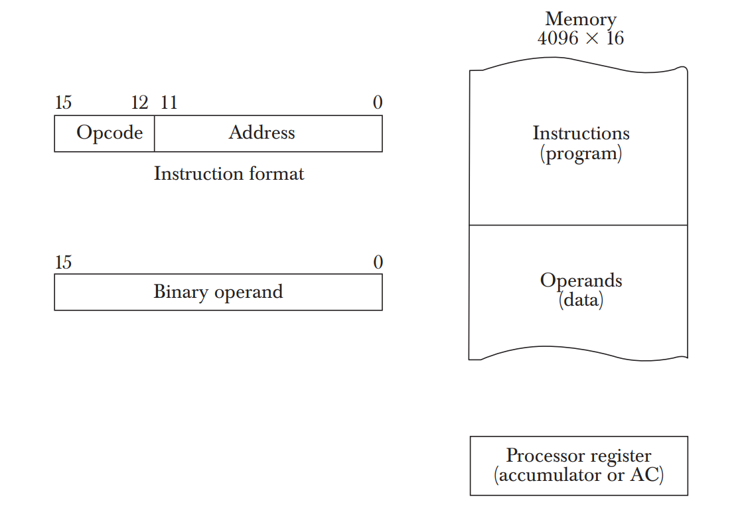
Stored Program Organization
Instructions are stored in one section of the memory and data in another.
For a memory unit with 4096 words we need 12 bits to specify an address since 2¹²=4096.
4 bits are available for opcode to specify one out of 16 possible operations.

Slide 34
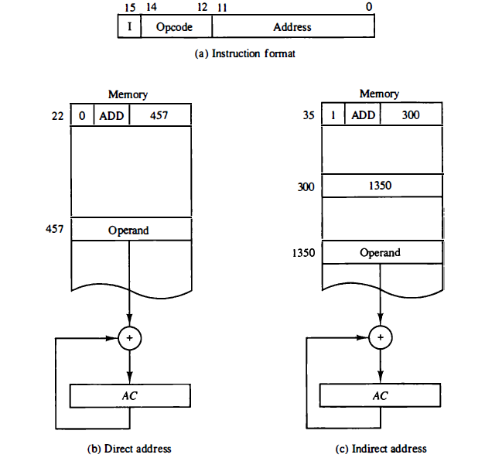
Direct and Indirect Addressing Modes
Following Addressing Modes are used for address portion of the instruction code.
Direct- The address part specifies the address of an operand.
Indirect- The address part specifies a pointer(another address) where the address of the operand can be found.
One bit of the instruction code(I) can be used to distinguish between a direct and an indirect address.

Slide 35
Steps
The control unit reads a 16-bit instruction from the program portion of memory.
It uses the 12-bit address part of the instruction to read a 16-bit operand from the data portion of memory.
It then executes the operation specified by the operation code.
The operation is performed with the memory operand and the content of AC.

Slide 36
Effective Address
It is the address of the operand in a computation-type instruction or the target address in a branch-type instruction.
The effective address in the instruction of the figures are 457 and 1350.

Slide 37
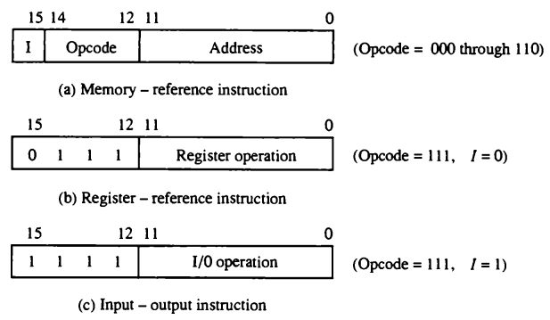
Basic Computer Instruction Formats
The basic computer has three instruction code formats, as shown in Figure.
Each format has 16 bits. The operation code (opcode) part of the instruction contains three bits and the meaning of the remaining 13 bits depends on the operation code encountered. A memory-reference instruction uses 12 bits to specify an address and one bit to specify the addressing mode I.
I is equal to 0 for direct address and to 1 for indirect address.

Slide 38
The register-reference instructions are recognized by the operation code 111 with a 0 in the leftmost bit (bit 15) of the instruction.
A register-reference instruction specifies an operation on or a test of the AC register. An operand from memory is not needed; therefore, the other 12 bits are used to specify the operation or test to be executed.
Similarly, an input—output instruction does not need a reference to memory and is recognized by the operation code 111 with a 1 in the leftmost bit of the instruction. The remaining 12 bits are used to specify the type of input—output operation or test performed.

Slide 39
Instruction format
The type of instruction is recognized by the computer control from the four bits in positions 12 through 15 of the instruction.
If the three opcode bits in positions 12 though 14 are not equal to 111, the instruction is a memory-reference type and the bit in position 15 is taken as the addressing mode I.
If the 3-bit opcode is equal to 111, control then inspects the bit in position 15. If this bit is 0, the instruction is a register-reference type. If the bit is 1, the instruction is an input—output type.
Note that the bit in position 15 of the instruction code is designated by the symbol I but is not used as a mode bit when the operation code is equal to 111.

Slide 40
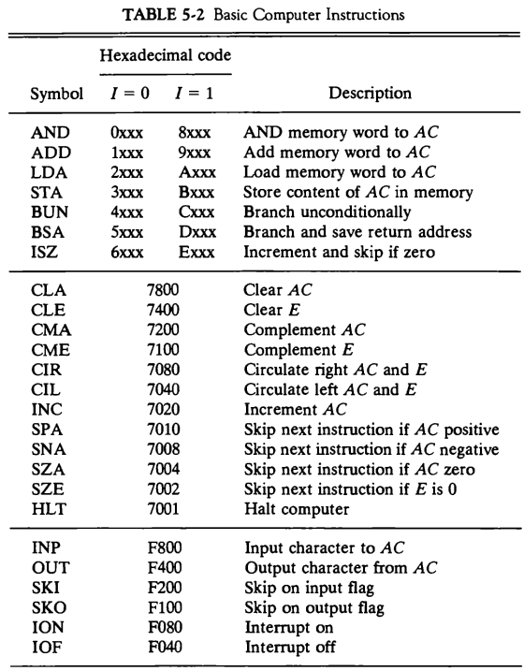
Basic Computer Instructions

Slide 41
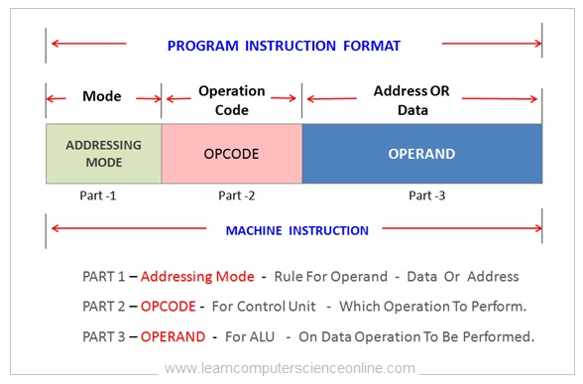
Addressing Mode
Instruction Fields
OP-code field - specifies the operation to be performed
Address field - designates memory address(es) or a processor register(s)‏
Mode field - determines how the address field is to be interpreted (to
get effective address or the operand)‏
The number of address fields in the instruction format depends on the internal organization of CPU
The two most common CPU organizations:
Single accumulator organization (One address field):
ADD X /* AC ← AC + M[X] */
General register organization (two/three address field):
ADD R1, R2, R3 /* R1 ← R2 + R3 */
ADD R1, R2 /* R1 ← R1 + R2 */
MOV R1, R2 /* R1 ← R2 */
ADD R1, X /* R1 ← R1 + M[X] */

Slide 42
THREE, AND TWO-ADDRESS INSTRUCTIONS
Three-Address Instructions
Program to evaluate X = (A + B) * (C + D) :
ADD R1, A, B /* R1 ← M[A] + M[B] */
ADD R2, C, D /* R2 ← M[C] + M[D] */
MUL X, R1, R2 /* M[X] ← R1 * R2 */
- Results in short programs
- Instruction becomes long (many bits)‏
Two-Address Instructions
Program to evaluate X = (A + B) * (C + D) :
MOV R1, A /* R1 ← M[A] */
ADD R1, B /* R1 ← R1 + M[A] */
MOV R2, C /* R2 ← M[C] */
ADD R2, D /* R2 ← R2 + M[D] */
MUL R1, R2 /* R1 ← R1 * R2 */
MOV X, R1 /* M[X] ← R1 */

Slide 43
ONE INSTRUCTIONS
One-Address Instructions
- Program to evaluate X = (A + B) * (C + D) :
LOAD A /* AC ← M[A] */
ADD B /* AC ← AC + M[B] */
STORE T /* M[T] ← AC */
LOAD C /* AC ← M[C] */
ADD D /* AC ← AC + M[D] */
MUL T /* AC ← AC * M[T] */
STORE X /* M[X] ← AC */

Slide 44
Addressing Modes
Addressing Modes– The term addressing modes refers to the way in which the operand of an instruction is specified. The addressing mode specifies a rule for interpreting or modifying the address field of the instruction before the operand is actually executed.
The various kind of addressing modes:
Implied Mode
Immediate Mode
Register Mode
Register Indirect Mode
Direct Address Mode
Indirect Address Mode

Slide 45
TYPES OF ADDRESSING MODES
Implied Mode
Address of the operands are specified implicitly in the definition of the instruction
- No need to specify address in the instruction
- Examples from Basic Computer
CLA, CME
Immediate Mode
Instead of specifying the address of the operand, operand itself is specified
- No need to specify address in the instruction
- However, operand itself needs to be specified
- Sometimes, require more bits than the address
- Fast to acquire an operand
-Examples from Basic Computer
MOV 25H

Slide 46
TYPES OF ADDRESSING MODES
Register Mode
In this mode the operands are in the register that resides in the CPU. Address specified in the instruction is the register address.
- Designated operand need to be in a register
- Shorter address than the memory address
- Saving address field in the instruction
- Faster to acquire an operand than the memory addressing
Examples from Basic Computer
MOV R2
Register Indirect Mode
Instruction specifies a register which contains the memory address of the operand.
- Saving instruction bits since register address is shorter than the memory address
- More Faster than others
- Examples from Basic Computer
MOV R1,M[R2]

Slide 47
TYPES OF ADDRESSING MODES
Addressing Modes
Direct Address Mode
In this mode the effective address is equal to the address part of the instruction. Instruction specifies the memory address which can be used directly to access the memory.
Examples from Basic Computer
MOV M[X]
Indirect Addressing Mode
In this mode the address field of the instruction gives the address where the effective address is stored in memory. The address field of an instruction specifies the address of a memory location that contains the address of the operand.
- Slow to acquire an operand because of an additional memory access
- EA = M[X]
MOV M{M[X]}

Slide 48
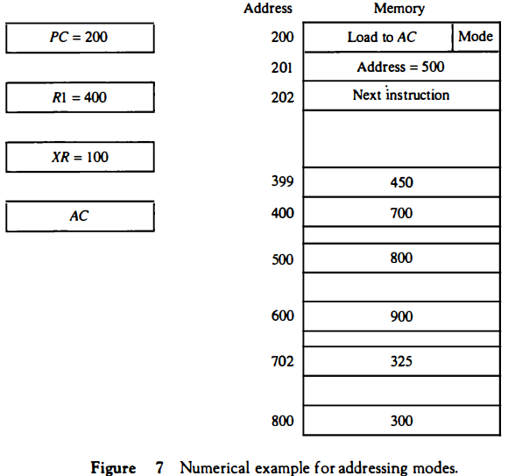
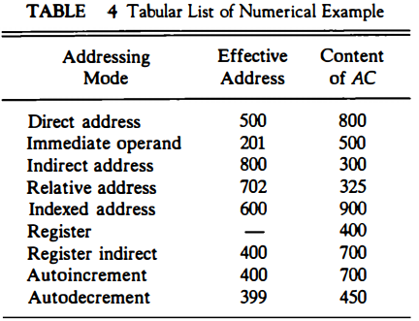
Addressing Modes (Cont..)
Numerical Example for addressing Mode

Slide 49

INSTRUCTION CYCLE
In Basic Computer, a machine instruction is executed in the following cycle:
Fetch an instruction from memory
Decode the instruction and calculate effective address (EA)
Read the EA from memory if the instruction has an indirect address (Fetch operand)
Execute the instruction
After an instruction is executed, the cycle starts again at step 1, for the next instruction
Note: Every different processor has its own (different) instruction cycle

Slide 50
DETERMINE THE TYPE OF INSTRUCTION
Start
SC ← 0
AR
←
PC
T0
AR: Address Register
PC: Program Counter
IR: Instruction Register
SC: Sequence Counter
T1
IR
←
M[AR],
PC
←
PC + 1
T2
Decode Opcode in IR(12-14),
AR
←
IR(0-11),
←
I
IR(15)
(Register or I/O)
D7
opcode ≠ 111 (Memory-reference)
(I/O) = 1
= 0 (register)
(indirect) = 1
= 0 (direct)
I
I
T3
T3
T3
T3
Execute
Execute
AR
←
M[AR]
Nothing
input-output
register-reference
instruction
instruction
SC
←
0
SC
←
0
Execute
T4
memory-reference
instruction
SC
←
0
D'7IT3: AR ← M[AR]
D'7I'T3: Nothing
D7I'T3: Execute a register-reference instr.
D7IT3: Execute an input-output instr.

Slide 51
NUMBER SYSTEM
Number system is a basis for counting varies items. Modern computers communicate and operate with binary numbers which use only the digits 0 &1. Basic number system used by humans is Decimal number system.
For Ex: Let us consider decimal number 18. This number is represented in binary as 10010.
We observe that binary number system take more digits to represent the decimal number. For large numbers we have to deal with very large binary strings. So this fact gave rise to three new number systems.
i) Octal number systems
ii) Hexa Decimal number system
iii) Binary Coded Decimal number(BCD) system To define any number system we have to specify.
To define any number system we have to specify
Base of the number system such as 2,8,10 or 16.
The base decides the total number of digits available in that number system.
First digit in the number system is always zero and last digit in the number system is always base-1.

Slide 52
Binary number system:
The binary number has a radix of 2. As r = 2, only two digits are needed, and these are 0 and 1. In binary system weight is expressed as power of 2.
The left most bit, which has the greatest weight is called the Most Significant Bit (MSB). And the right most bit which has the least weight is called Least Significant Bit (LSB).

Slide 53
Continue..
The human beings use decimal number system while computer uses binary number system.
Therefore it is necessary to convert decimal number system into its equivalent binary.
i) Binary to octal number conversion
ii) Binary to hexa decimal number conversion

Slide 54
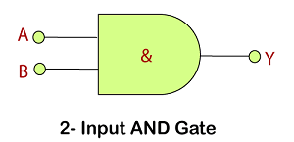
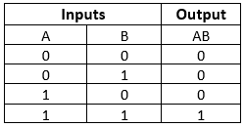
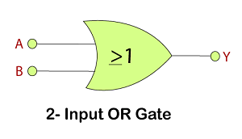
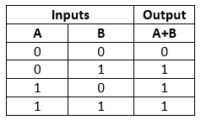
Digital Logic gates

Slide 55
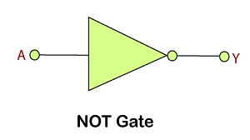
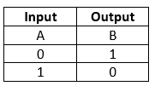
Continue..

Slide 56
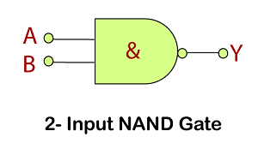
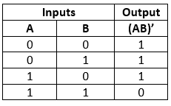
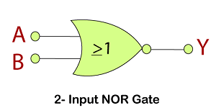
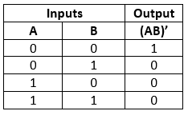
Universal gates

Slide 57
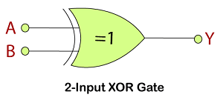
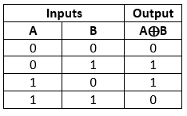
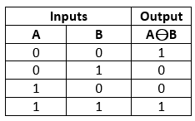
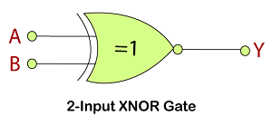
Additional gates

Slide 58
Binary numbers and arithmetic

Slide 59
Addition (binary)

Slide 60
Representing signed (positive and negative) numbers

Slide 61
Methods for representing signed ints.
signed magnitude
1’s complement
2’s complement

Slide 62
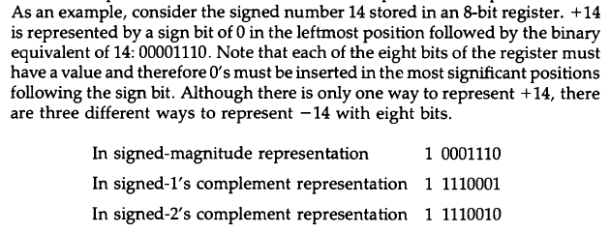
signed magnitude

Slide 63
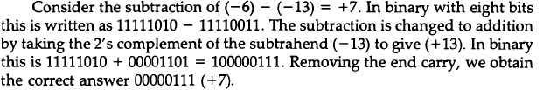
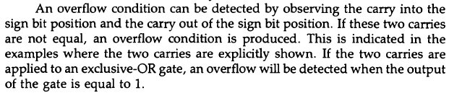
Arithmetic Subtraction

Slide 64
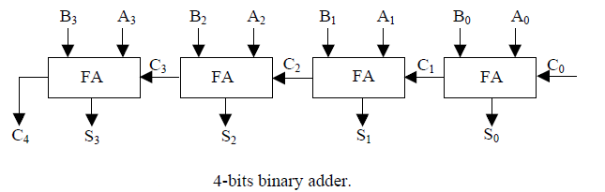
Binary Carry Adder
0101=5
0100=4

Slide 65
Binary Arithmetic
Signed magnitude

Slide 66
Rules

Slide 67
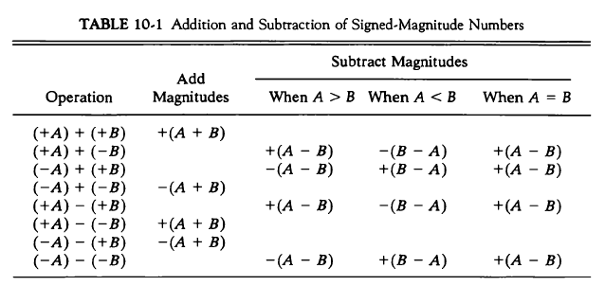
Addition signed magnitude algorithm

Slide 68
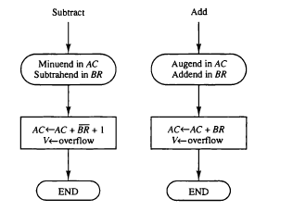

Subtraction
The algorithm for adding and subtracting numbers in signed 2’s complement representation is shown below:-

Slide 69
multiplication

Slide 70
Multiplication (decimal)
Multiplicand
Multiplier
Product
Here left shift is performed

Slide 71
Multiplication (binary)
It’s interesting to note that binary multiplication is a sequence of shifts and adds of the first term (depending on the bits in the second term.
110100 is missing here because the corresponding bit in the second terms is 0.

Slide 72
Multiplication (binary)
If sign of Multiplier and Multiplicand are same, then sign of the product is positive
If they are unlike, sign of product is negative
Here right shift is performed instead of left shift
When a corresponding bit of multiplier is 0, there is no need to add all zeros to the partial product
One bit is for sign and n-1 bits are for magnitude
Final product is in A (MSBs)and Q(LSBs)

Slide 73
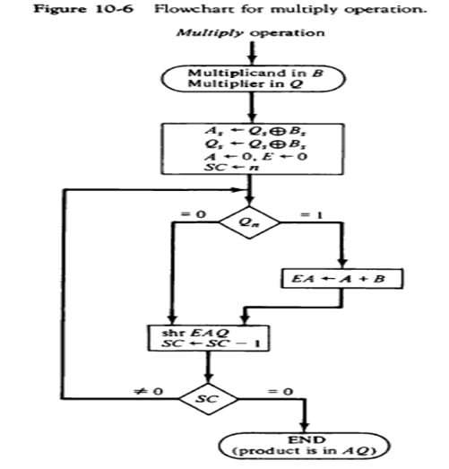
Multiplication Algoritham

Slide 74
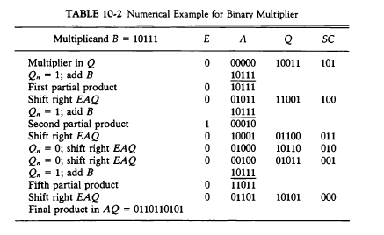
Multiplication

